Slide 1

Business Buccaneers MIS 4173 Capstone Project
Paige Lowery – Project Manager
William Kozel – Systems Analyst
Johann Quintero – Business Analyst
Jack Fentzke - Programming Coordinator

Slide 2
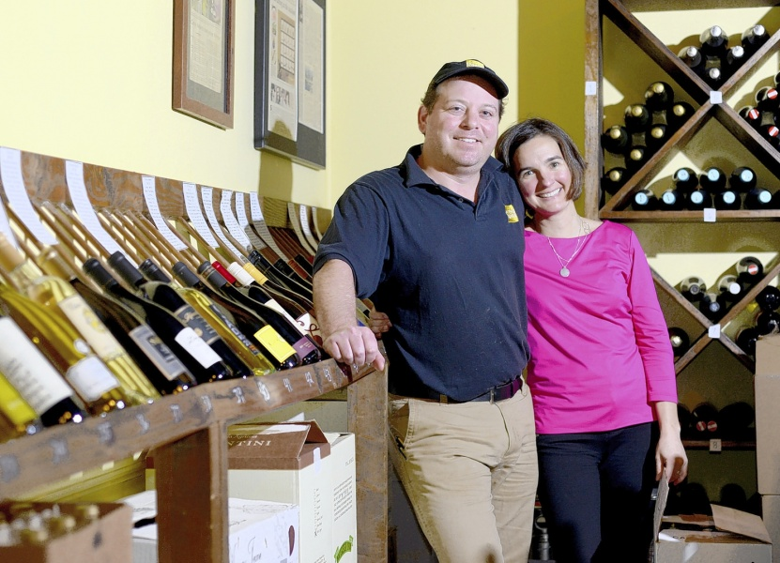
Current Environment
Small, local restaurant operated in Tarboro, NC
Stephen and Inez Ribustello – Owners and Executive Chef
No customer loyalty program
Outdated system for updating customers on promotions

Slide 3
Hardware/Software Specifications
Hardware:
Core i5 processor
1920X1080 monitor
DVI video output
USB Keyboard & Mouse
Ethernet connection
Software:
Microsoft Windows 10
Microsoft .NET Framework 4.6 (Or Higher)
Microsoft Access

Slide 4
Non-functional Requirements
Reliability | High user testing to ensure uptime during heavy business hours
Serviceability | Needs to be easily worked on so that the user can correct errors
Scalable | Must be able to accept large number of menu items, guests, and reward items
Usable | System shall be easily understood by staff with little knowledge of CRMs
Secure | System shall be able to easily perform backups of data
Modern | System shall be able to run on current PC hardware

Slide 5
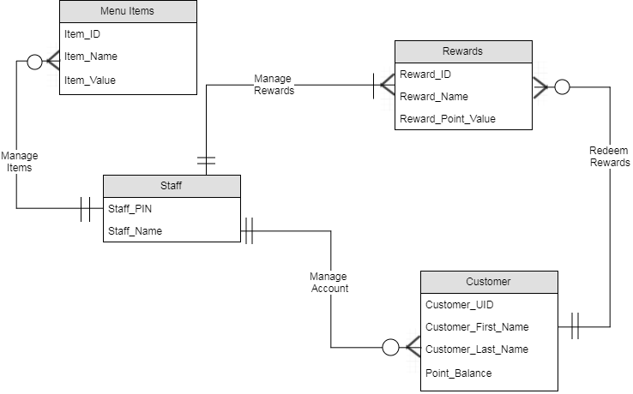
ERD

Slide 6
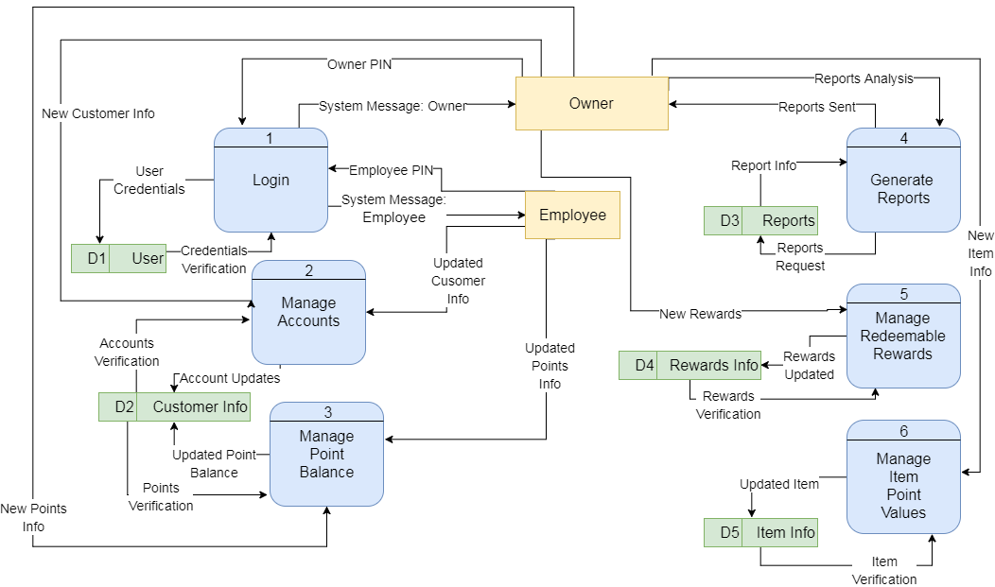
DFD – Level 0

Slide 7
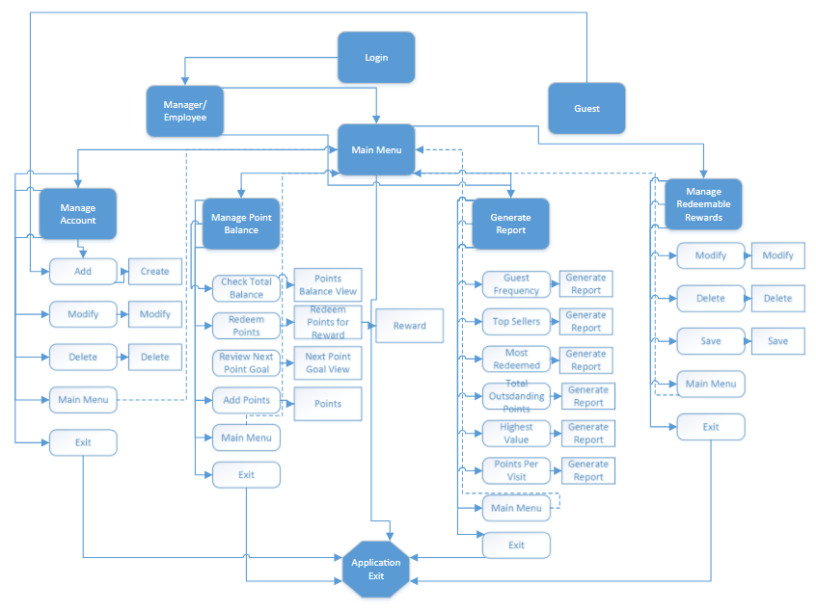
Navigation Diagram

Slide 8
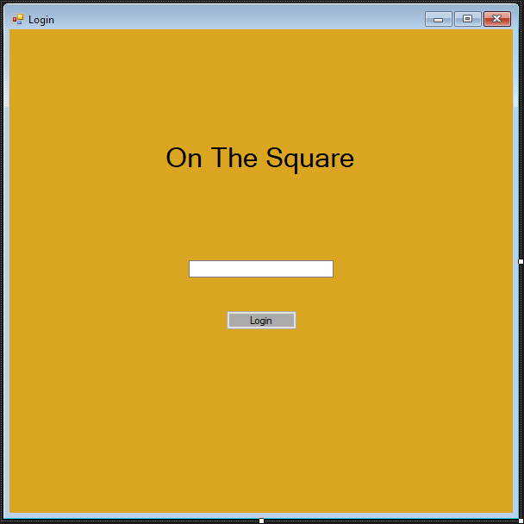
Mock Forms

Slide 9
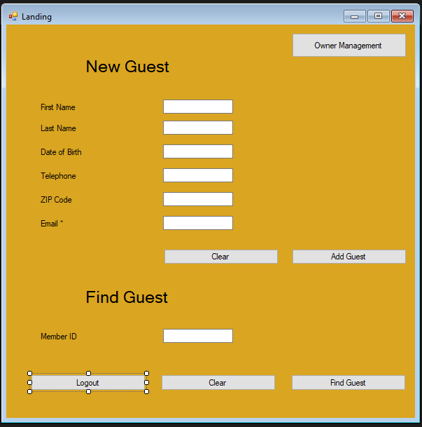
Mock Forms

Slide 10
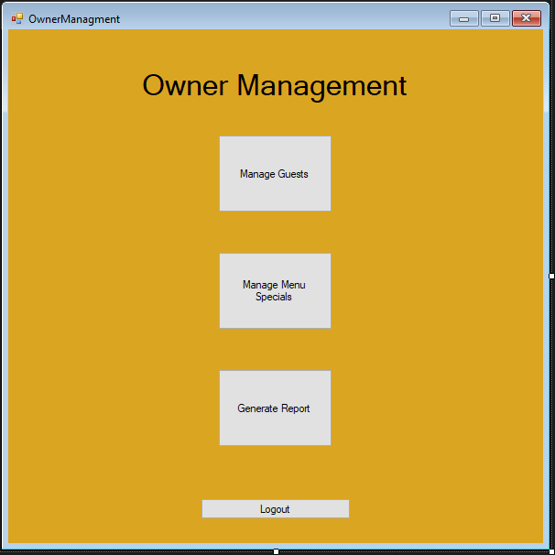
Mock Forms

Slide 11
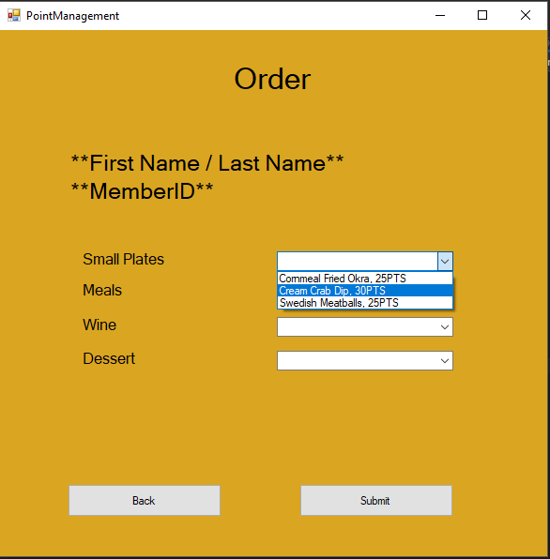
Mock Forms

Slide 12
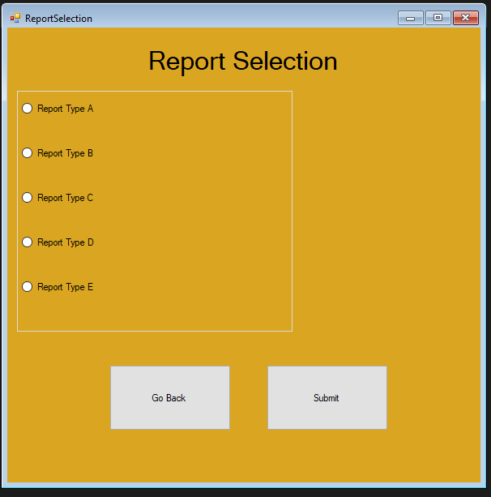
Mock Forms

Slide 13
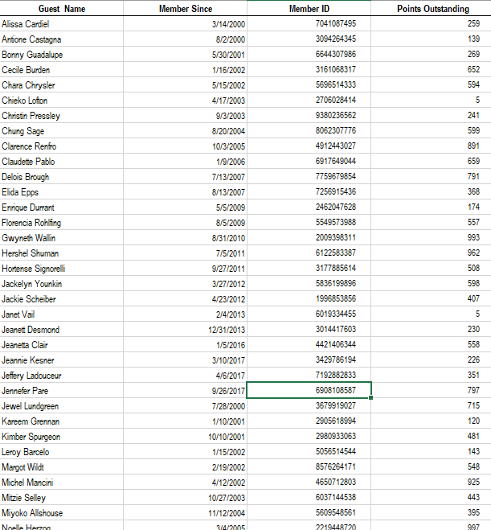
Sample Reports

Slide 14
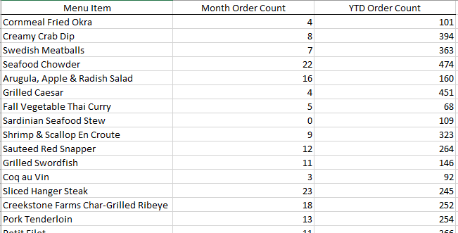
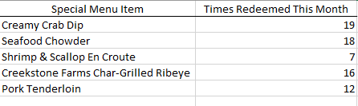
Sample Reports

Slide 15
Questions and Feedback?

